Slide 1

APEX INSTITUTE OF TECHNOLOGY
COMPUTER SCIENCE & ENGINEERING
Human Security Assistance System with GPS Location Tracking and Messaging System
ANUSHKA 21CBS1001
MUKTA TEHRI 21CBS1003
ADITYA AMITABH 21CBS1033
KAPHI RANI21CBS1059

Slide 2
Feature/characteristics Identification
External Features: These are the visible, outward-facing elements of a design or structure. For example, external features might include the materials, additional features, an inbuilt airsoft gun, taser, flairs, pepper spray, etc. Reverse Engineering Leads to New Understanding of Products
Internal Features: These refer to the aspects of a design or structure that are not readily visible from the outside. internal features could include the layout of components, functionalities, electrical systems, insulation, and purpose.

Slide 3
Internal features
For a Human Security Assistance System with GPS Location Tracking and Messaging System, you'll want to identify key features and characteristics to ensure the system's effectiveness and functionality. Here are some important features and characteristics to consider:
1. GPS Location Tracking:
- Real-time tracking of the user's location using GPS technology.
- Ability to pinpoint the user's location on a map.
- Location history tracking for route analysis and retrospective tracking.

Slide 4
2. Geofencing (since we are using google maps): - Ability to define geographical boundaries and trigger alerts when the user enters or exits specified areas. - Useful for safety in predefined zones or for tracking specific areas of interest. 3. Emergency Services Integration: - Integration with emergency services (e.g., police, medical, fire) for rapid response when an emergency is detected.

Slide 5
4. User Profile and Information:
- User profile creation with personal details, medical information, and emergency contacts.
- Secure storage and access to user information for first responders.
5. Alerts and Notifications:
- Customizable alerts for various situations, including medical emergencies, falls, or deviations from planned routes.
- Push notifications and SMS alerts to designated contacts.

Slide 6
6. Data Privacy and Security:
- Robust data encryption and secure storage to protect user information.
- Strict adherence to data privacy regulations and best practices.
7. Integration with Wearable Devices:
- Compatibility with wearable devices (e.g., smartwatches) for convenient access to safety features.
8. Legal and Regulatory Compliance:
Compliance with local and international laws and regulations related to tracking, privacy, and emergency services.
These features and characteristics are essential for a comprehensive Human Security Assistance System with GPS Location Tracking and Messaging to ensure the safety and security of users in various situations. The specific implementation may vary depending on the target user group and use cases.

Slide 7
Constraint Identification
Identification of Security Constraints:
The system should be able to identify a wide range of security constraints or potential risks. These may include:
Natural disasters (e.g., earthquakes, floods, wildfires).
Medical emergencies (e.g., injuries, illnesses).
Physical security threats (e.g., accidents, criminal activities).
Environmental hazards (e.g., air pollution, extreme weather).
Health and safety concerns (e.g., disease outbreaks, food

Slide 8
Constraint Identification
Types of Constraints:
Constraints can encompass a wide range of factors that pose potential threats to human security. These constraints may include:
Environmental Constraints: Such as natural disasters (e.g., earthquakes, floods, hurricanes), extreme weather conditions, air quality issues, or geological hazards.
Medical Constraints: Including health emergencies, injuries, illnesses, or the need for medical assistance.
Security Constraints: Such as accidents, criminal activities, physical threats, or unsafe environments.
Communication Constraints: Including network outages or breakdowns in communication systems.
Location Constraints: Constraints related to the individual's geographical location or proximity to known hazards.

Slide 9
Constraint Identification
Data Sources:
To identify constraints, the system may rely on various data sources, including:
Environmental sensors (e.g., weather stations, air quality monitors).
User-generated reports (e.g., distress signals, emergency requests).
Geographic information systems (GIS) data.
Social media feeds for real-time updates on incidents.

Slide 10
Constraint Identification
Data Analysis and Monitoring:
The system continuously analyzes data from multiple sources to detect anomalies or patterns indicative of security constraints.
Machine learning and data analytics techniques can be employed to recognize unusual events or trends.

Slide 11
Constraint Identification
Human Security Assistance:
The system is designed to provide assistance and support to individuals facing security challenges. This could involve alerting authorities, offering guidance, or facilitating communication with relevant emergency services.
GPS Location Tracking:
GPS (Global Positioning System) location tracking is a fundamental feature of the system. It allows the system to determine the precise location of individuals in distress. This information is critical for responding effectively to emergencies.

Slide 12
Methodology
1. GPS Location Tracking
Real-time tracking
Location pinpointing
Location History
2. Distance and Geolocation Calculation:
Check to see if your browser supports the Geolocation API.
To acquire the user's current position, use getCurrentPosition if it is available.
Using the Haversine formula, calculate the distance between the two spots.
3. Logging on the console:
To the browser console, save the timestamp, latitude, longitude, and distance.

Slide 13
5. Prototype Number Extension:
Add a toRad method to the Number prototype to convert degrees to radians.
6. Execution of the Interval:
Set the interval to 1000 milliseconds (1 second) to call the getLocation method periodically.
7. Handling Errors:
If the browser does not allow geolocation, display a notice in the console.
8. Enhancements:
For a more comprehensive application, the code may be improved by integrating user interface components, error handling, and optional server-side processing.

Slide 14
10. Data Analytics and Reporting:
User behavior tracking
Reporting for system and user safety
11. Offline Capabilities:
Partial functionality without network we can callculate the distance from initial and final.
13. Customization and Scalability:
Customizable features(refresh rate *default=1000mil sec*)
Scalable for user growth
14. Legal and Regulatory Compliance:
Compliance with tracking, privacy, and emergency service laws.

Slide 15
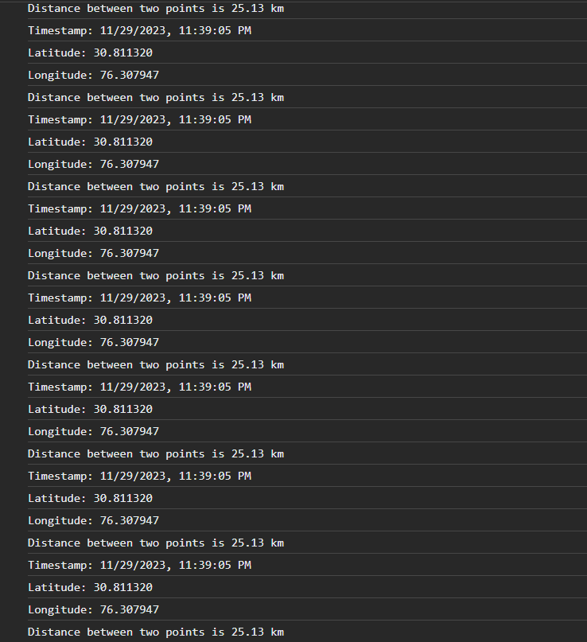
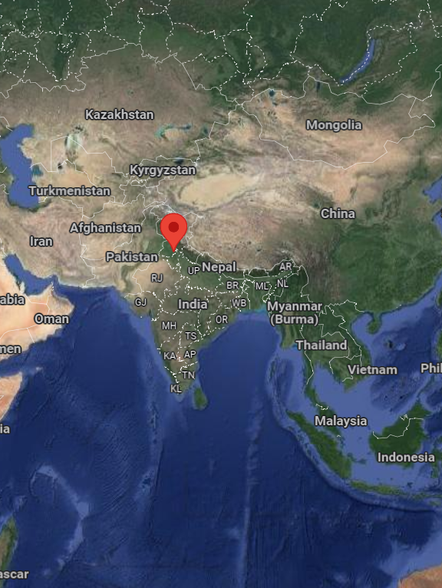
longitude and latitude with time and date
displayed
coordinates plot on map

Slide 16
Analysis of Features
Main Features
GPS Location
GPS tracking
Data Privacy and Security
User Profile and Information
DATE of tracking
TIME of tracking
Distance from initial and final
Latitude and Longitude display

Slide 17
Finalizing Subject to Constraints
Connectivity Challenges:
Limited or unreliable network and GPS signals can affect real-time tracking and communication.
Battery Life Concerns:
The need for continuous GPS tracking and communication can strain device battery life.
Data Privacy and Compliance:
Stringent privacy regulations and concerns around user data security must be addressed.
Emergency Service Variability:
Diverse emergency service protocols and response times may impact integration.
Customization Complexity:
Accommodating user preferences and customization adds complexity to the system.
Addressing these constraints is crucial for the successful implementation and functionality of your Human tracking and safety system.

Slide 18
References
[1] Abhijit Paradkar, Deepak Sharma “All in one Intelligent Safety System for Women Security” International Journal of Computer Applications, Volume 130, No. 11, November 2015.
[2]S. Shambhavi, M. Nagaraja, and M. Z. Kurian, “Smart Electronic System for Women Safety,” International Journal of Innovative Research in Electrical, Electronics, Instrumentation and Control Engineering, vol. 4, Issue 3, March 2016.
[3] A. Santhiya, B. Hariprakash, J. Mithilaesh, K. Valarmathi, “Android Based Women Tracking System Using GPS and GSM” International Journal for Research in Applied Science & Engineering Technology, Volume 4, Issue 4, April 2016.
[4] A. Usha Kiran Reddy, P. Sushmitha Gayathri, K. Sandhya, and N. Suresh, “Self Defense System for Women Safety with Location Tracking and SMS Alerting, International Journal of Innovative Technologies, vol. 5, Issue 4, April-2017, pp. 590-592.
[5] R. Pavithra, P. S. Sangeetha, M. Shakthi Devi, S. Vanila, “Design and Implementation of a Rescue System for the Safety of Women by using Arduino Controller.”

Slide 19
[6] Wellington, Vishnu Prasad, Karthick. C, “Review On Women Safety in System Access Control Using RFID Technique,” International Journal of Pure and Applied Mathematics, vol. 117, no. 21, pp. 163-167, 2017.
[7] Sourav Kumar Pradhan, Vivi Holo, Shanti Bhusan Acharya, “GSM and ADHAR based safety management system through Smart Poles: A step towards safety for humanistic Society (Women),” in International Research Journal of Engineering and Technology, vol. 5, no. 3, March 2018.
[8] Sonali S. Kumbhar, Sonal K. Jadhav, Prajakta A. Nalawade, and Tamanna Y. Mutawalli, “Women security system using GSM and GPS,” in International Research Journal of Engineering and Technology, vol. 5, no. 3, March 2018.

